Slide 1
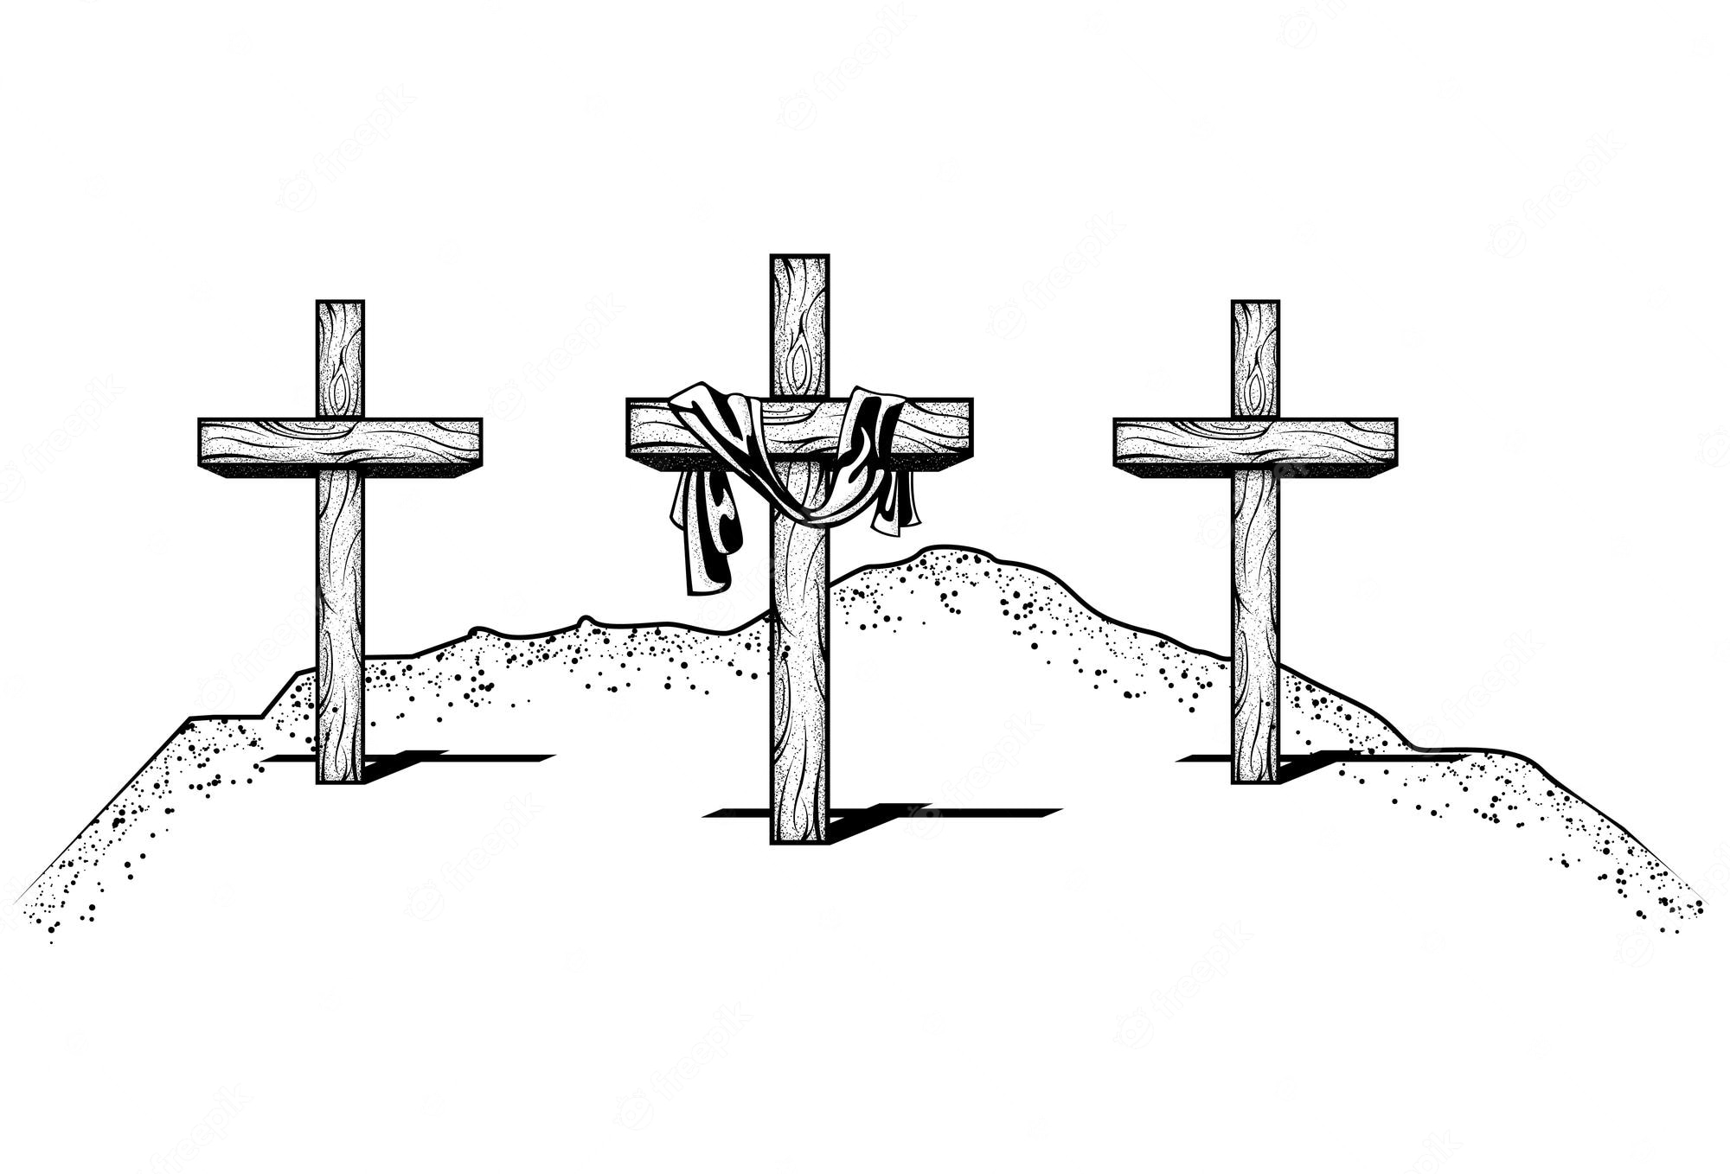
Conversions at Calvary – Part II (The Centurion)
2nd Sunday April 9, 2023

Slide 2
Events Leading to the Conversion of the Centurion
1. One of the first events is the fact that Pilate declares Jesus Christ to be innocent. In Luke’s gospel, Pilate says to the mob, . . . “I have found in Him no guilt . . .” (Luke 23:22) As Pilate hands Jesus over to the centurion, instead of hearing the crimes committed against the state that justify the death sentence, he and his soldiers watch, according to Matthew’s account, Pilate wash his hands in a ceremonial manner and say, . . . “I am innocent of this Man’s blood . . .” (Matthew 27:24) The centurion was a soldier who had given his life to protect and uphold the law of the land, and his leader just announced that this criminal had never broken the law.

Slide 3
2. The second event is an unusual exchange between Christ and a group of women. As they made their way through the streets of Jerusalem toward Calvary, the centurion and his soldiers would hear Christ make an unusual statement to the daughters of Jerusalem. Luke, in chapter 23, Women in the city were following Jesus and weeping because of His imminent death. They were weeping not as much because of their faith in Him as because of their remorse over a Jewish man being executed in this manner by the Romans. The centurion hears Christ say to them, . . . “Daughters of Jerusalem, stop weeping for Me . . . weep for yourselves and for your own children.” (Luke 23:28)

Slide 4
3. The third event that would have mystified the soldiers is Christ’s refusal to drink the wine mixed with myrrh. History records the custom of the Daughters of Jerusalem to, out of compassion for the condemned, provide wine mixed with myrrh – a narcotic drink intended to ease the pain of the crucified victim. Mark’s gospel informs us that when Christ reached the Skull, He was offered this drink but . . . . . . He did not take it. (Mark 15:23) Christ had work to do on the cross; He had things to say and would not be in a stupor. He would face death without an anesthetic so that every word could be trusted; so that every final act could be recorded and freighted with divine meaning.

Slide 5
4. The fourth event is that Christ offers the soldiers forgiveness as they nail Him to the cross. Luke writes further in chapter 23, When they came to the place called The Skull... (Luke 23:33a) This place is “Golgotha,” in Greek, “The Skull”. This was the nickname for the hill of execution. Now notice, . . . there they crucified Him and the criminals, one on the right and the other on the left. But Jesus was saying [that is, kept saying], “Father, forgive them; for they do not know what they are doing.” And they cast lots, dividing up His garments among themselves. (Luke 23:33b-34) The centurion heard this Man offer forgiveness to his soldiers for what they were doing.

Slide 6
5. The fifth event is the pleading of one of the criminals to be given entrance into Christ’s kingdom. The criminal’s eyes had been opened by the grace of God to the truth of Christ. He says, . . . “Jesus, remember me when You come into Your kingdom!” (Luke 23:42) There is no doubt the centurion had already mulled over the meaning of the words on the placard behind Jesus’ head that declared Christ’s only crime, . . . “This is Jesus, the King of the Jews.” (Matthew 27:37) Now this soldier hears one of the condemned cry out to Jesus in faith, asking that Jesus allow him to enter His kingdom. Today you shall be with Me in Paradise.” (Luke 23:43) Certainly the centurion is amazed, who is this man.

Slide 7
6. The sixth event is total darkness that sweeps in and covers the land. Luke tells us that darkness blankets the earth at the sixth hour and that it lasts until the ninth hour (Luke 23:44). The sixth hour happens to be noon! When the sun is at its zenith, it suddenly gets turned off like a light bulb. Matthew tells us, . . . darkness fell upon all the land . . . (Matthew 27:45) The word that is translated “land” is the Greek refer to a region or to the entire world. This darkness is the judgment of God the Father who abandons His Son as He bears the wrath of the Father, representing the wrath of Triune God, against the sins of the whole world.

Slide 8
7. The seventh event occurs when the centurion hears the cry of agony and abandonment of Christ. Suddenly, out of the darkness, Jesus cries, . . . “My God, My God, why have You forsaken Me?” (Mathew 27:46) The centurion would have noticed that Jesus is not referring to God as His Father. For the first time in scripture, Jesus does not address God as His Father. Jesus bears the wrath of God by not only bearing our sin, but becoming sin on mankind’s behalf in order that those who believe in Him might be saved from the penalty of their sin. The centurion hears Jesus cry out, . . . “My God, My God, why have You forsaken Me?” (Mathew 27:46)

Slide 9
We might think, “Wait, didn’t Jesus know? In the agony of His suffering, had He forgotten the plan of salvation crafted before the foundation of the world (Revelation 13:8)? Jesus was not saying these words because He had forgotten. He was making this statement to clearly connect His dying to the prophesies of scripture. Christ happens to be quoting and fulfilling Psalm chapter 22, which is the prophetic Psalm in which David expresses his own personal agony and sense of separation from God. Jesus Christ is expressing the agony of separation from His Father, but He is expressing it in a way that connects the specifics of death by crucifixion with the words of scripture.

Slide 10
8. The eighth event occurs when the centurion hears Christ deliver a shout of completion. When the darkness is about to lift, John’s gospel records that Jesus cries out, . . . “It is finished!” . . . (John 19:30) This statement is one word in the Greek language, “tetelestai,” which literally means, “paid in full”. The gospel was being delivered in a word. Jesus did not cry out, “I am finished,” but “It is finished!” The perfect tense of this verb that He shouted means “It is finished and it always will be finished.” This is the cry of the believer’s deliverance, the shout of their forgiveness, the declaration of their eternal justification. This is not the end of story; it is merely picking up speed!

Slide 11
Luke then includes this final word as Jesus says, . . . “Father, into Your hands I commit My spirit.” . . . (Luke 23:46) The centurion hears Jesus reverting back to calling God “Father”. Why did Jesus do this? Because it was finished! In the darkness, on the cross Christ had paid the eternal sacrifice for our sins and now, no longer abandoned, Christ offers up His spirit to the care of His Father.

Slide 12
9. One of the final events that the centurion will literally feel is an earthquake. As Christ bows His head in death, Mathew records that the earth began to shudder and shake so violently that rocks split apart (Matthew 27:51). In Jewish history, an earthquake was a sign of the presence of God. This was true even to a Gentile Roman soldier – he had seen enough. It is no wonder that the centurion stood at the cross and said, . . . “Truly this was the Son of God!” (Matthew 27:54) It all makes sense – the compassion, the dignity, the promise of a kingdom, the communication with God His Father, the darkness, the earthquake . . . “Truly this was the Son of God!”

Slide 13
A Roman soldier is the first Gentile convert after the death of Christ – a conversion at Calvary. From Luke’s account, this centurion was not quiet about his conversion either. The text says, . . . he began praising God . . . (Luke 23:47) The “Hallelujahs of the Cross” came first from the lips of a redeemed centurion. Imagine that! He came to faith beneath the dead Savior’s cross. He believed that this dead Man was indeed the King with a coming kingdom – the Son of God. We place our faith in Him because He rose again – and surely He had to in order to validate His claim. We place our faith in Him because He is alive. The centurion placed his faith in Him even though He had just died.

Slide 14
This soldier was the first to begin singing praises to God for the sacrifice and sufficiency of Christ. And rightly so! The “Hallelujahs” can begin at Calvary, because at Calvary:
• the deal was done;
• forgiveness was finalized;
• the sacrifice was offered;
• Christ’s own lips declared, “It is and always will be finished.”
This is why Christians can look at a cross and do the unthinkable, the unimaginable – they can praise God and sing: On a hill far away stood an old rugged cross, The emblem of suffering and shame; And I love that old cross where the dearest and best For a world of lost sinners was slain.

